Slide 1
WE CLEAN AMRITA
AN ANDROID APP FOR INITIATING CLEAN-UP DRIVES

Slide 2
AIM
The main objective of this project is to keep the environment clean by bringing more awareness among the local residents about the proper waste disposal techniques

Slide 3
CLEAN-UP DRIVES
Aims to raise environmental awareness in different communities
Promote waste reduction, recycling and reuse
Help reduce the greenhouse gases and fight climate change
Improve outdoor recreational activities
Set one’s mind on the well-being of future generation

Slide 4
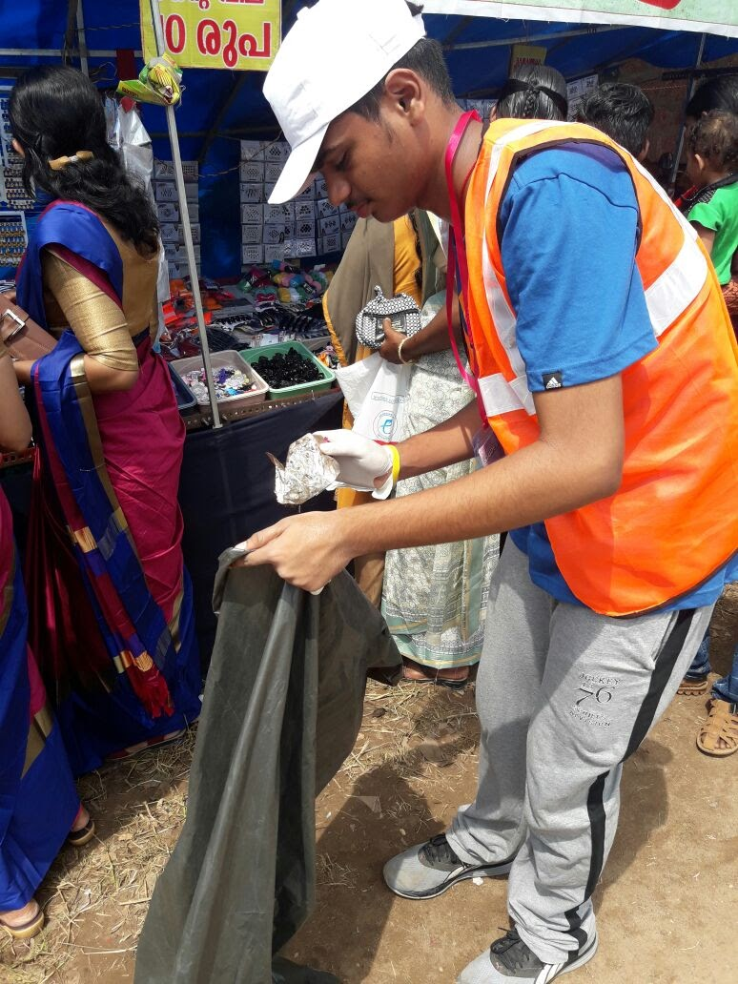
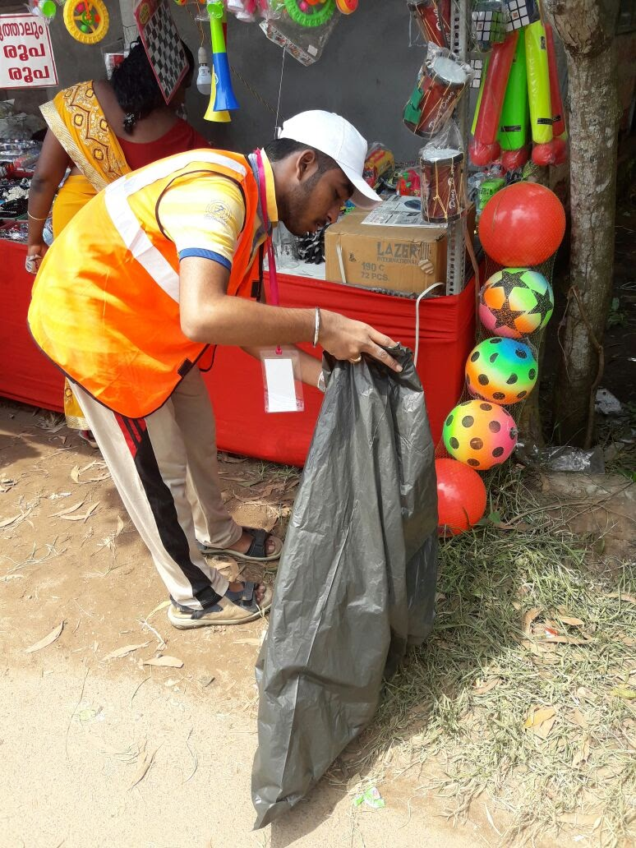

Slide 5
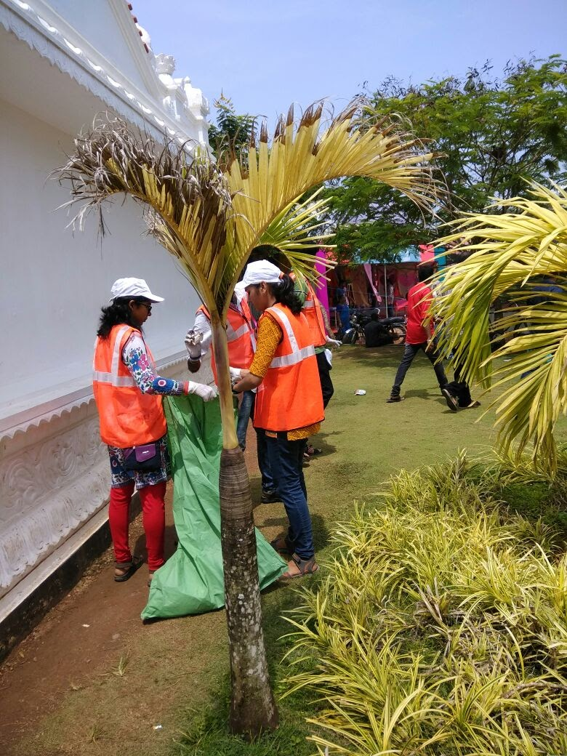
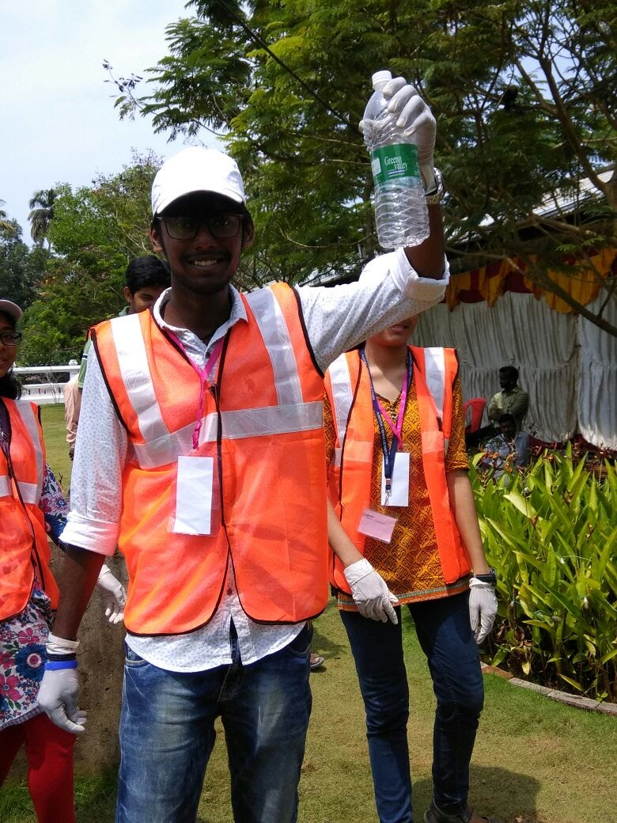
AMRITAPURI CAMPUS 2017

Slide 6
WE CLEAN AMRITA ANDROID APPLICATION

Slide 7
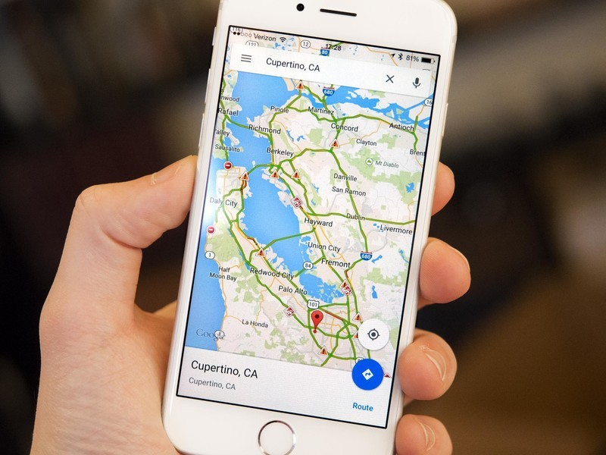

Slide 8
MOTIVATION FOR THE PROJECT
Popular
Easy adoption
Open source

Slide 9
ABOUT THE APPLICATION

Slide 10
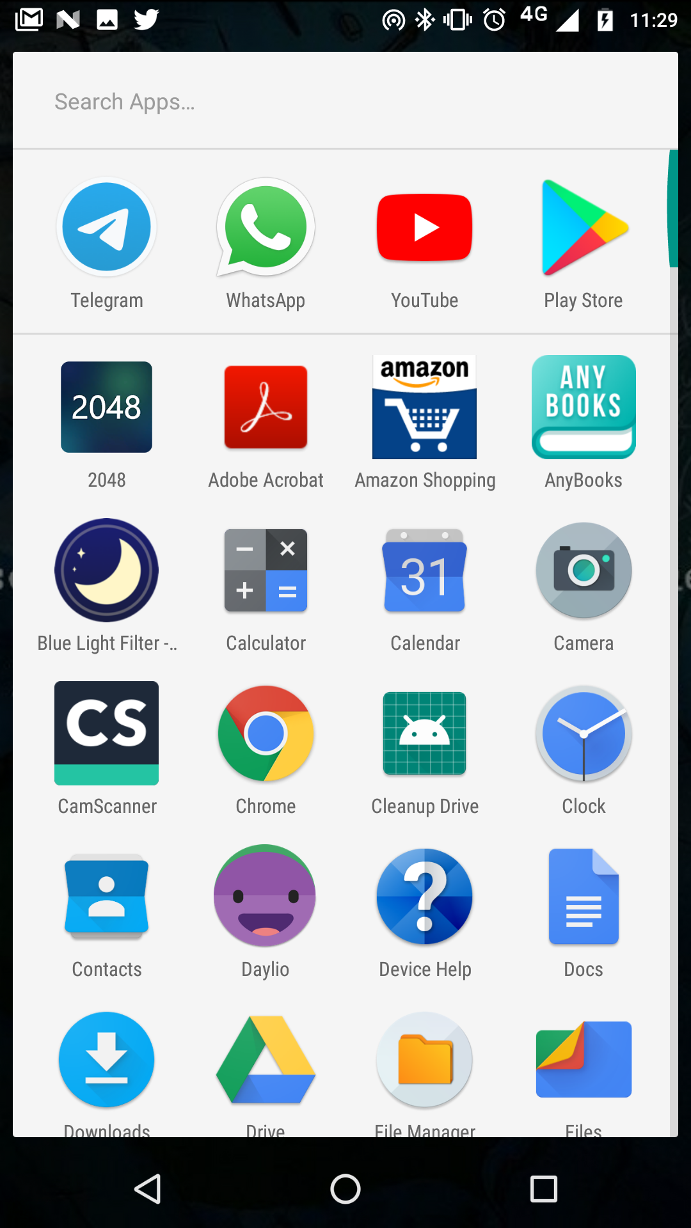

Slide 11
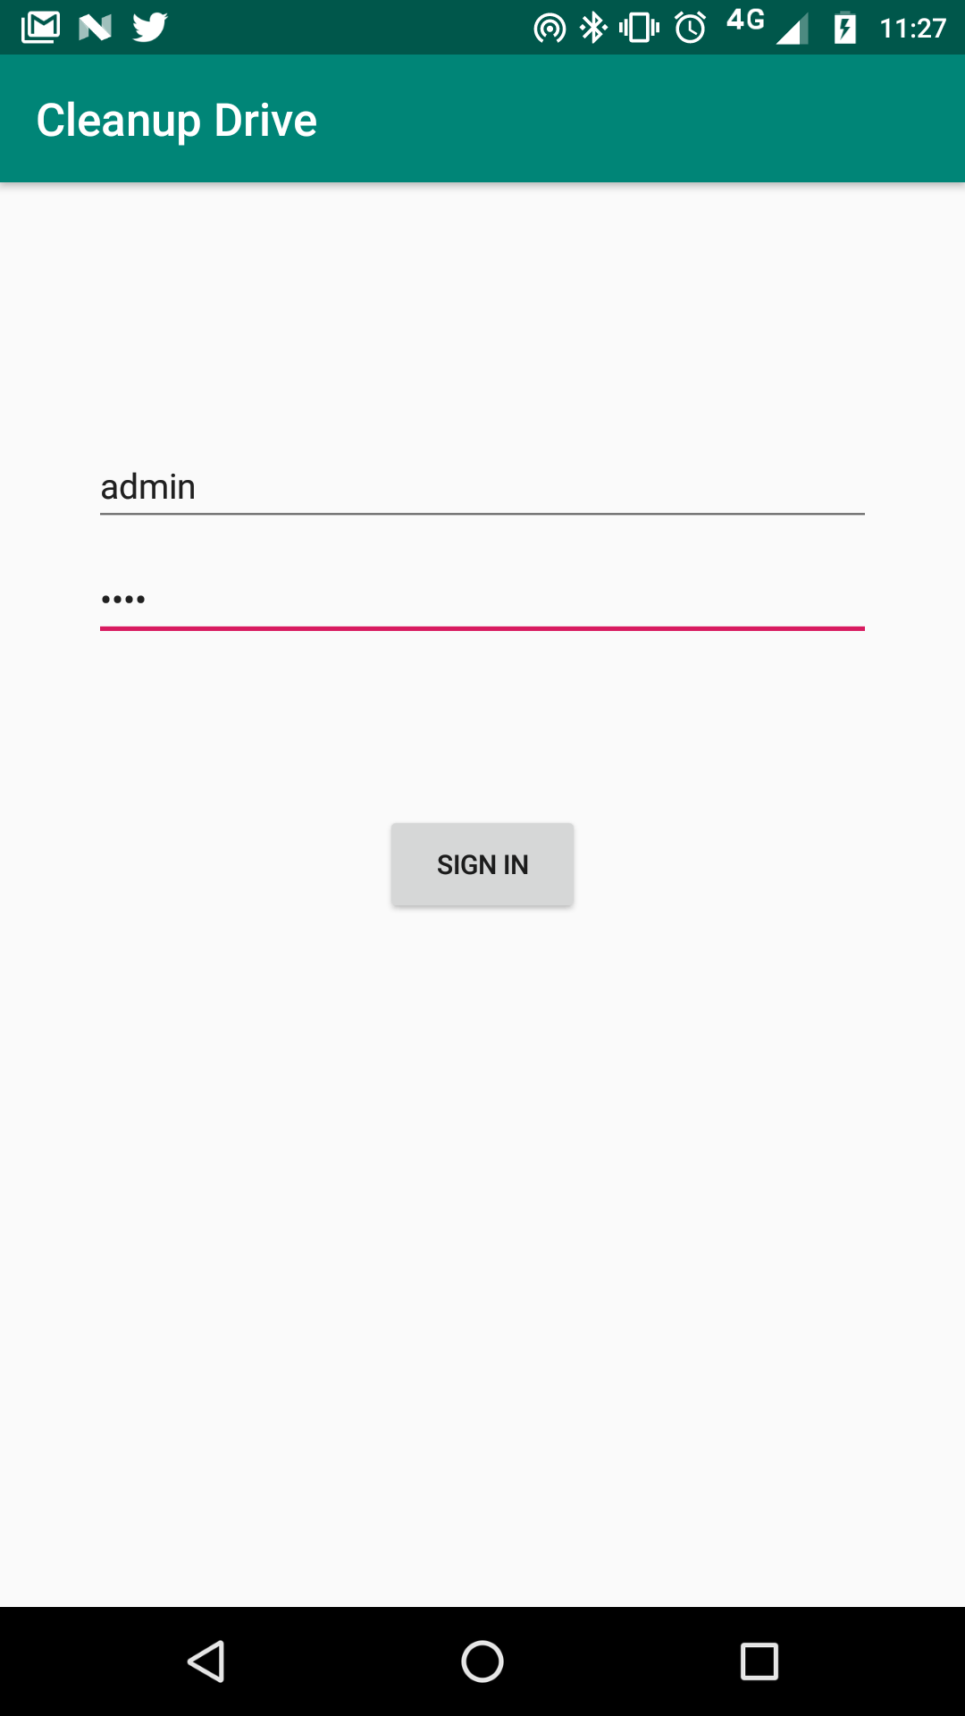
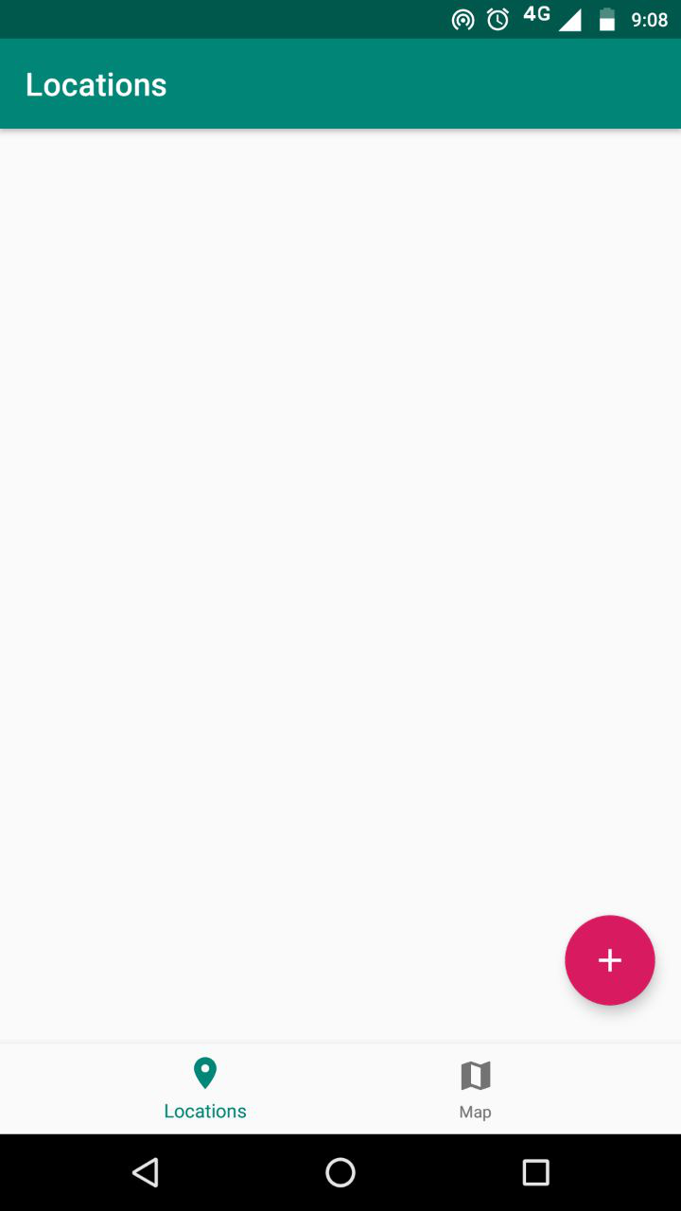

Slide 12
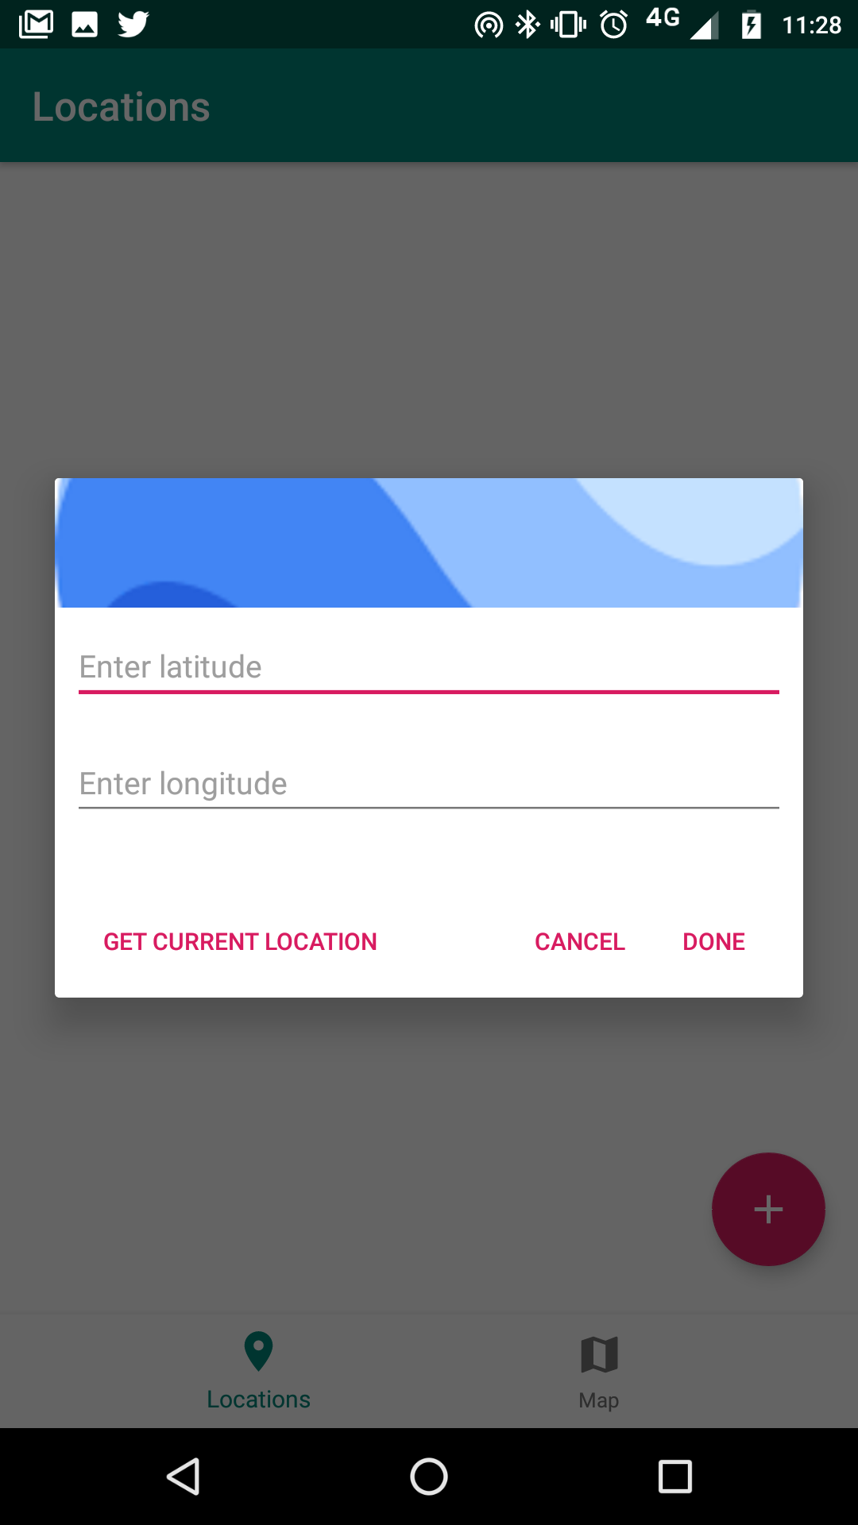
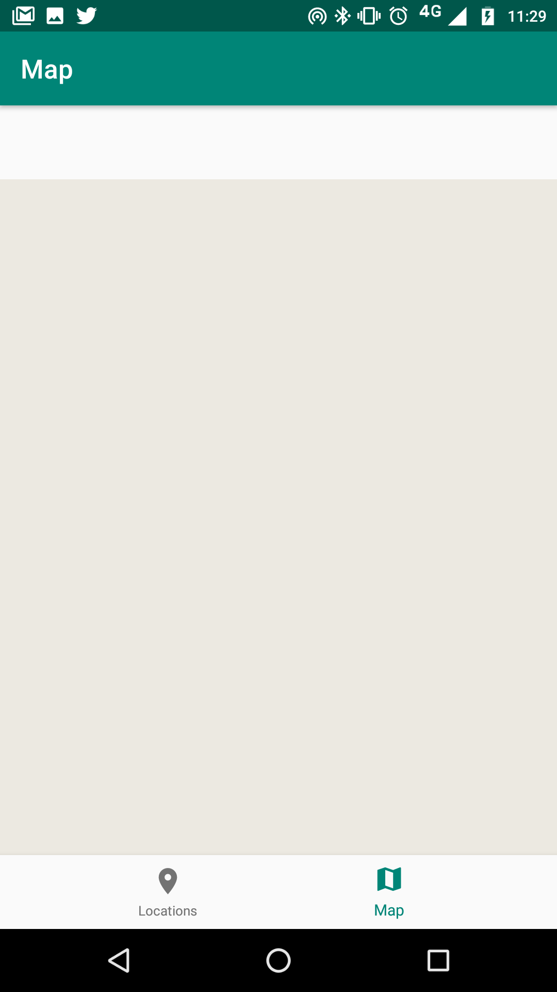

Slide 13
THANK YOU

